Slide 1
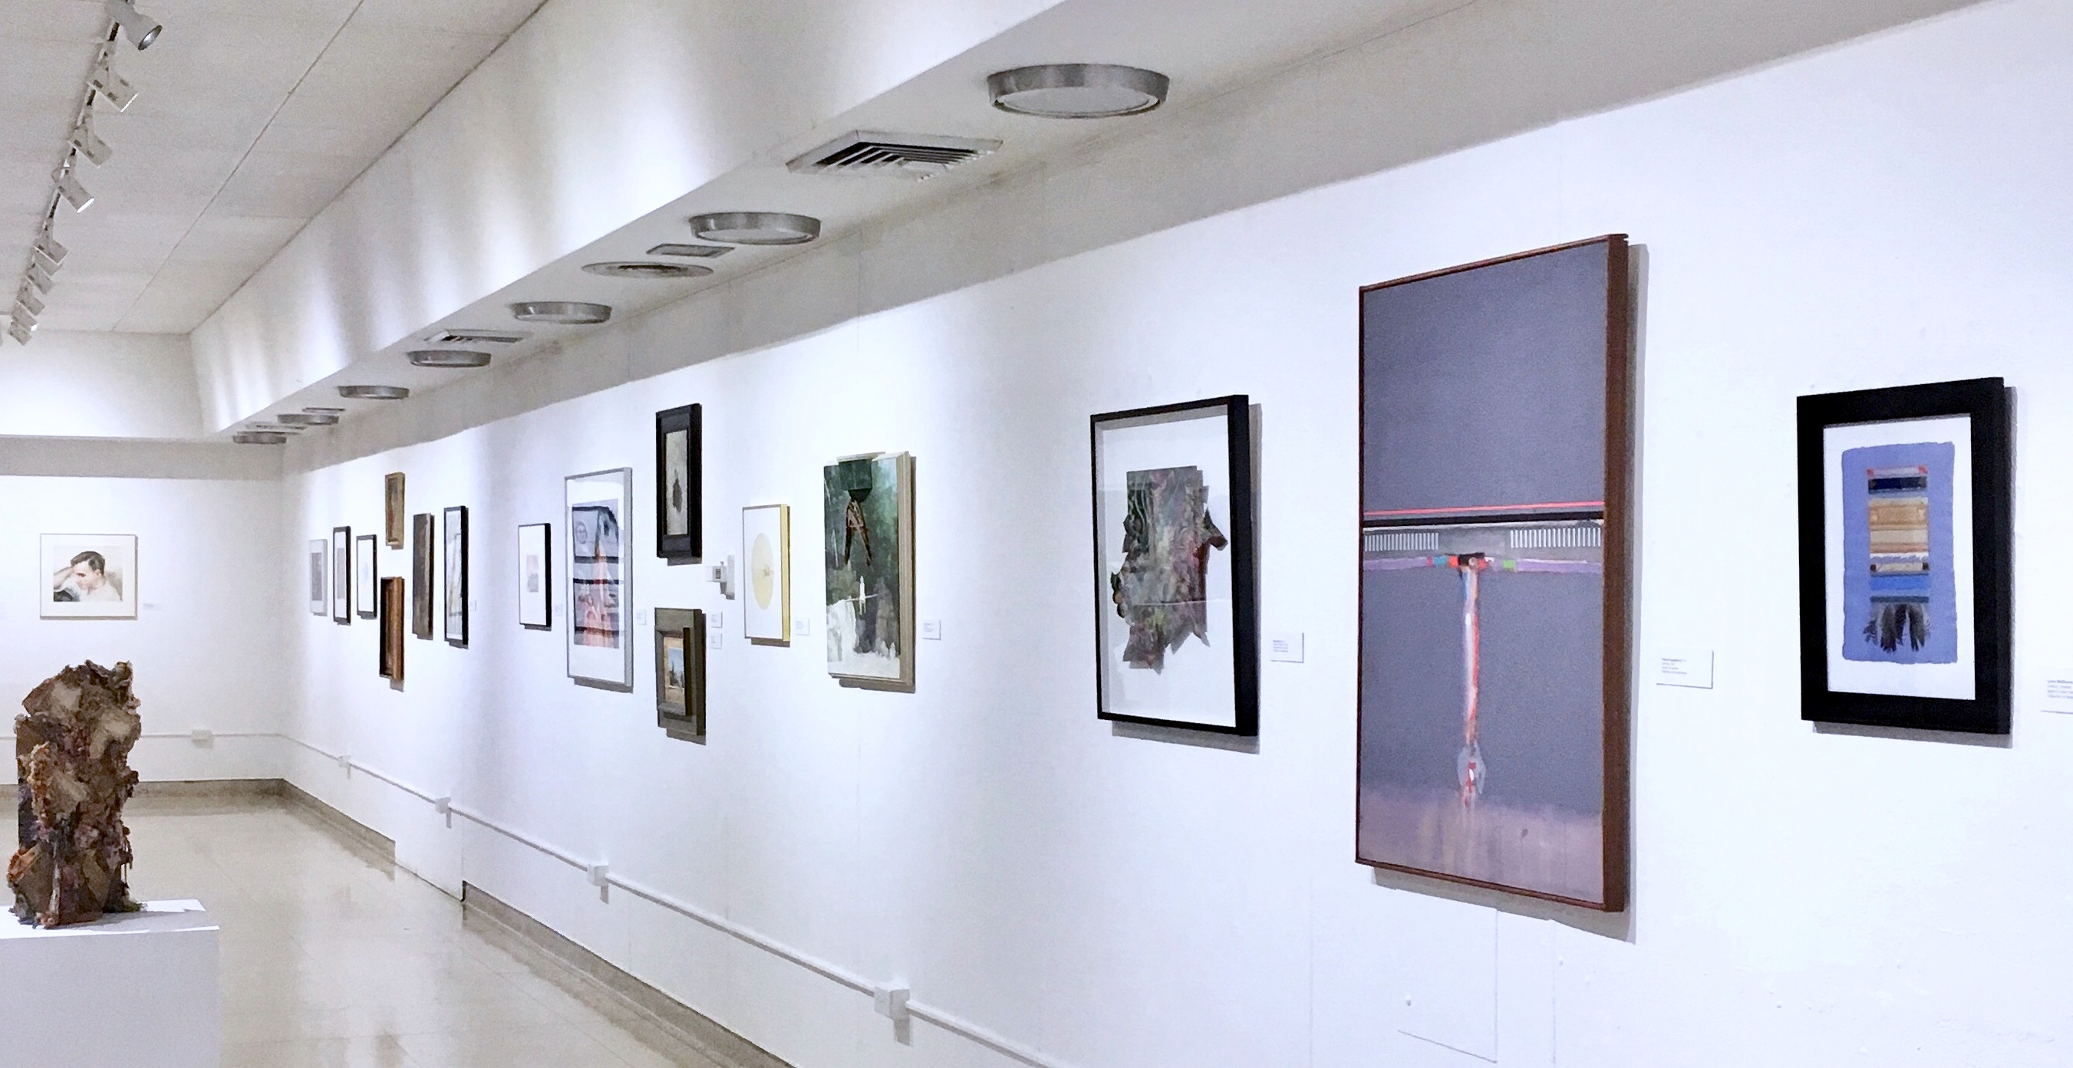
Welcome
BUFFALO STATE ART & DESIGN DEPARTMENT

Slide 2
Chelsea Manhollan
Art Education
For more information: https://artdesign.buffalostate.edu/art-education

Slide 3
Megan Tenney
Art Education
For more information: https://artdesign.buffalostate.edu/art-education

Slide 4
Szenina Russo
Art History
For more information: https://artdesign.buffalostate.edu/art-history

Slide 5
Sabina Mogavero
Art Education
For more information: https://artdesign.buffalostate.edu/ceramics

Slide 6
Heather Hartz
Ceramics
For more information: https://artdesign.buffalostate.edu/ceramics

Slide 7
Meg McCuen
Ceramics
For more information: https://artdesign.buffalostate.edu/ceramics

Slide 8
Liam Calhoun
Ceramics
For more information: https://artdesign.buffalostate.edu/ceramics

Slide 9
Elizabeth Dodge
Fibers
For more information: https://artdesign.buffalostate.edu/fibers

Slide 10
John Latona
Fibers
For more information: https://artdesign.buffalostate.edu/fibers

Slide 11
Landon Moreis
Fibers
For more information: https://artdesign.buffalostate.edu/fibers

Slide 12
Dante Feliciano
Drawing
For more information: https://artdesign.buffalostate.edu/painting-and-drawing

Slide 13
Kaitlyn Malinowski
Drawing
For more information: https://artdesign.buffalostate.edu/painting-and-drawing

Slide 14
Graphic Design
For more information: https://artdesign.buffalostate.edu/graphic-design

Slide 15
John Dejac
Graphic Design
For more information: https://artdesign.buffalostate.edu/graphic-design

Slide 16
Caitlin Waldron
Interior Design
For more information: https://artdesign.buffalostate.edu/interior-design

Slide 17
Rachel Crane
Interior Design
For more information: https://artdesign.buffalostate.edu/interior-design

Slide 18
Katelin Hamann
Interior Design
For more information: https://artdesign.buffalostate.edu/interior-design

Slide 19
Julia Pacer
Metals/Jewelry
For more information: https://artdesign.buffalostate.edu/metalsjewelry

Slide 20
Emily Ziegler
Metals/Jewelry
For more information: https://artdesign.buffalostate.edu/metalsjewelry

Slide 21
Ke Shi
Metals/Jewelry
For more information: https://artdesign.buffalostate.edu/metalsjewelry

Slide 22
Danielle Saeva
Painting
For more information: https://artdesign.buffalostate.edu/painting-and-drawing

Slide 23
Ann Pearson
Painting
For more information: https://artdesign.buffalostate.edu/painting-and-drawing

Slide 24
Jeremy Jindra
Photography
For more information: https://artdesign.buffalostate.edu/photography

Slide 25
Mukrimat Sanusi
Photography
For more information: https://artdesign.buffalostate.edu/photography

Slide 26
Jessica Rohl
Photography
For more information: https://artdesign.buffalostate.edu/photography

Slide 27
Madeline Brown
Printmaking
For more information: https://artdesign.buffalostate.edu/printmaking

Slide 28
Megan Himes
Printmaking
For more information: https://artdesign.buffalostate.edu/printmaking

Slide 29
Madeline Brown
Printmaking
For more information: https://artdesign.buffalostate.edu/printmaking

Slide 30
Lauren McAvoy
Sculpture
For more information: https://artdesign.buffalostate.edu/sculpture

Slide 31
Iron Pour
Sculpture
For more information: https://artdesign.buffalostate.edu/sculpture

Slide 32
Glen Stewart
Sculpture
For more information: https://artdesign.buffalostate.edu/sculpture

Slide 33
Andrew Peek
Wood/Furniture
For more information: https://artdesign.buffalostate.edu/woodfurniture

Slide 34
Matthew Burch
Wood/Furniture
For more information: https://artdesign.buffalostate.edu/woodfurniture

Slide 35
Noah Giusiano
Wood/Furniture
For more information: https://artdesign.buffalostate.edu/woodfurniture

Slide 36
YOU CAN FIND ANSWERS TO FREQUENTLY
ASKED QUESTIONS AT :
https://artdesign.buffalostate.edu/orientation-2020

